Slide 1

Uncertainty-Aware Road
Obstacle Identification
Luca Colamarino, 1944447
Matteo Zamponi, 1900496
Computer Vision course A.Y. 2024/2025
Prof. Irene Amerini

Slide 2
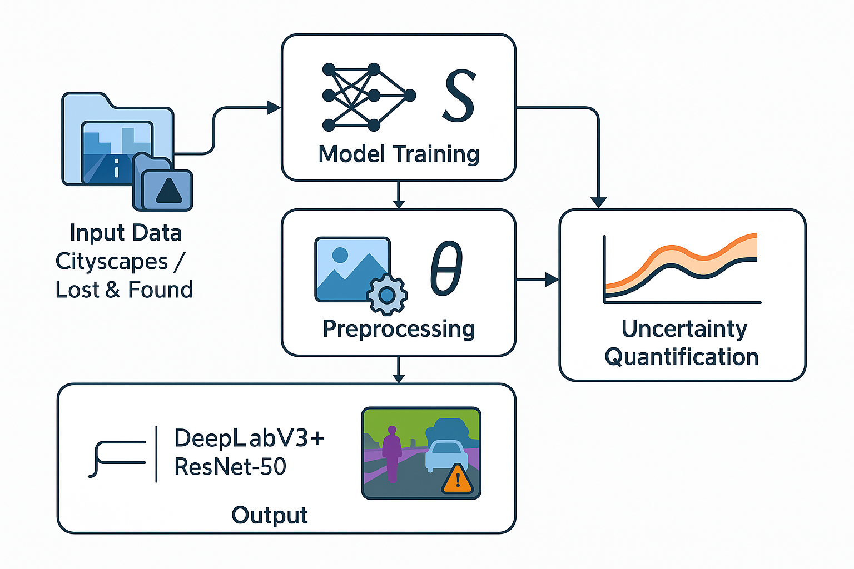
Workflow
Problem Statement: The addressed challenge
State of the Art: How current research approaches this challenge
Proposed Method: How we approached this challenge
Dataset: The data used for the project
Experimental Setup: How we configured the elements of the project
Model Evaluation: How we assessed the performance of our model
Conclusions: Final considerations and future work
References: Where we drew inspiration from

Slide 3
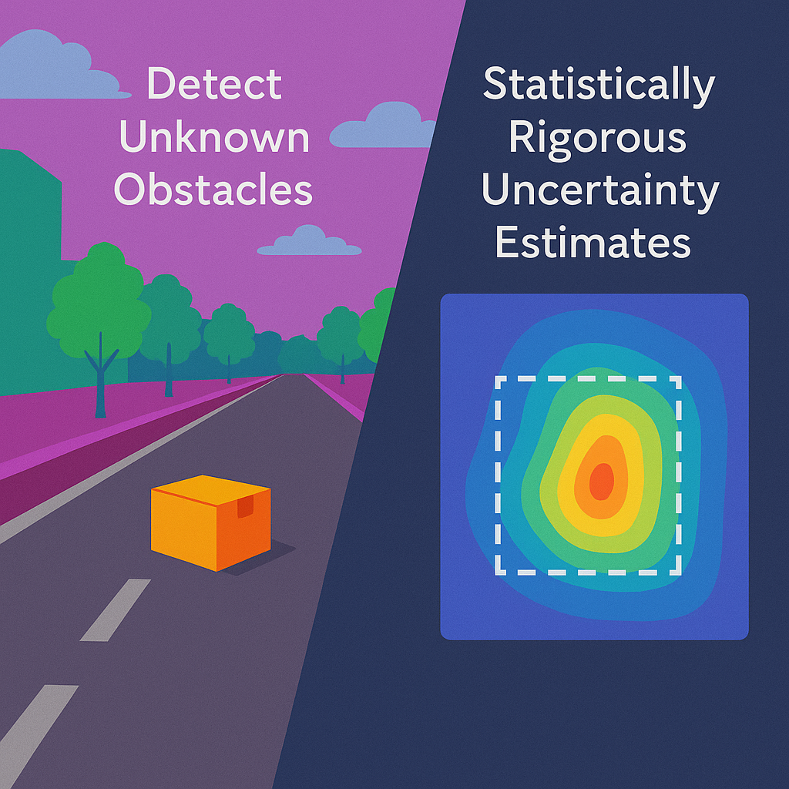
Problem Statement: The addressed challenge
Black-box machine learning models, especially in computer vision tasks like semantic segmentation, are increasingly used in safety-critical applications (e.g., autonomous driving, medical diagnostics).
A major challenge arises when these models encounter Out-of-Distribution (OoD) samples – objects or scenes not seen during training. Standard models often fail catastrophically on such inputs, either misclassifying them as known categories or providing overconfident, incorrect predictions.
This lack of uncertainty quantification and inability to detect unknown obstacles poses a significant safety risk. The core problem is to develop methods that can:
Accurately detect unknown obstacles (OoD objects) in real-world driving scenarios.
Provide statistically rigorous uncertainty estimates for segmentation predictions, even for known classes.

Slide 4
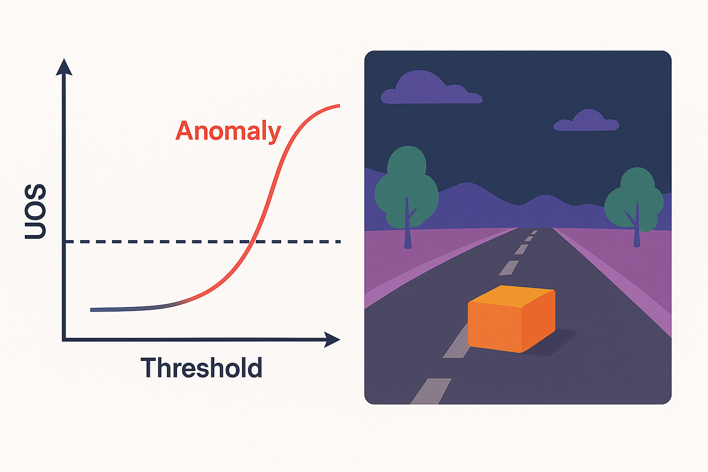
State of the Art: Out-of-Distribution (OoD) Detection for Semantic Segmentation
Traditional object detection methods struggle with unknown objects as they are trained to assign a background label to pixels corresponding to unknown objects.
Pixel-wise anomaly detection techniques (e.g., uncertainty estimation, perceptual difference from reconstructed images) have emerged to identify OoD samples. However, these can be unstable in complex driving scenes.
The "Road Obstacle Detection based on Unknown Objectness Scores" paper (Noguchi et al., 2024) proposes incorporating object detection concepts into pixel-wise anomaly detection. We implemented the Unknown Objectness Score (UOS) concept from this paper.

Slide 5

State of the Art: Conformal Prediction for Uncertainty Quantification
Conformal prediction is a user-friendly paradigm for creating statistically rigorous uncertainty sets/intervals.
It provides explicit, non-asymptotic guarantees without strong distributional or model assumptions.
The "A Gentle Introduction to Conformal Prediction and Distribution-Free Uncertainty Quantification" paper (Angelopoulos and Bates, 2022) provides foundational theory.
The "Conformal Semantic Image Segmentation: Post-hoc Quantification of Predictive Uncertainty" paper (Mossina et al., 2024) specifically applies conformal prediction to semantic image segmentation to generate statistically valid prediction sets guaranteed to include the ground-truth segmentation mask at a predefined confidence level.

Slide 6
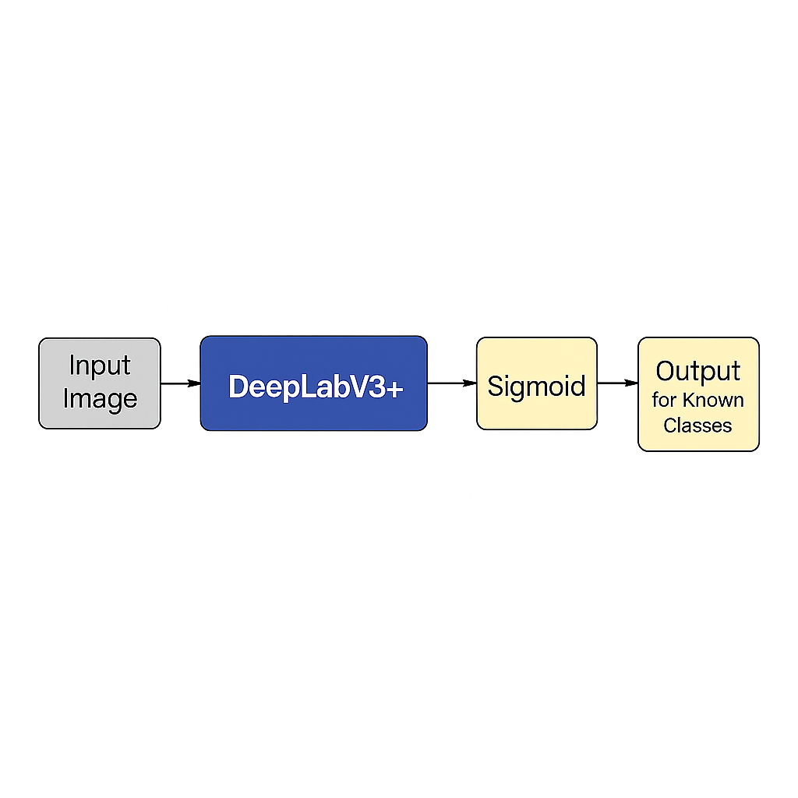
Proposed Method: Our model
Our proposed method combines a deep learning-based semantic segmentation model with two key techniques for robust uncertainty quantification and OoD detection:
DeepLabV3+ with Sigmoid Output for Known Classes:
We use a DeepLabV3_ResNet50 model as our base semantic segmentation architecture.
The final layer is configured to output NUM_KNOWN_CLASSES logits, followed by a sigmoid activation function for each class. This allows for independent probability estimation for each known class, enabling multi-label-like training and flexible uncertainty calculation.
Loss Function: CrossEntropy Loss is used, calculated per pixel per class, and masked to ignore irrelevant pixels (e.g., void labels).

Slide 7
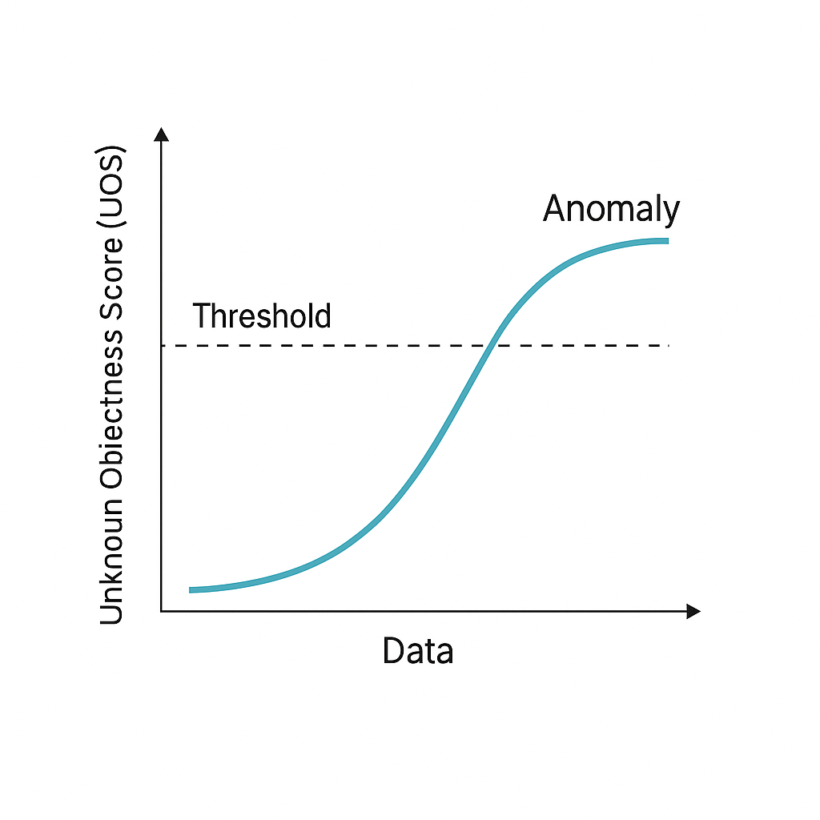
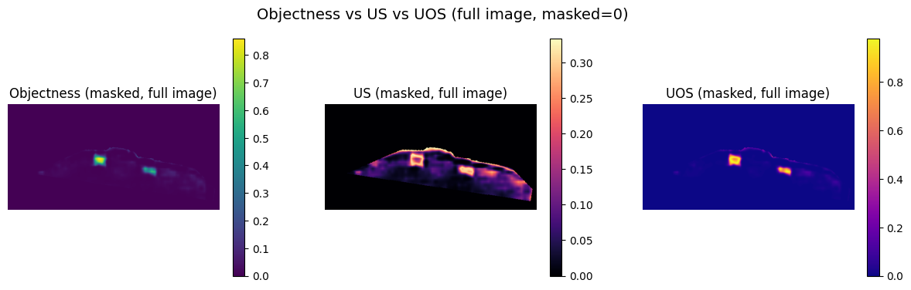
Proposed Method: Key technique 1
Unknown Objectness Score (UOS) for Anomaly Detection:
UOS is defined as: UOS=P_{O} × P_{US}, where P_{O} is an "objectness" score and P_{US}​ is the "unknown score".
A high UOS indicates a high likelihood of an unknown obstacle.
UOS is used to identify and highlight OoD pixels, effectively treating them as an "eighth" class (UNKNOWN_OBSTACLE_ID = 7) in combined segmentation maps.

Slide 8
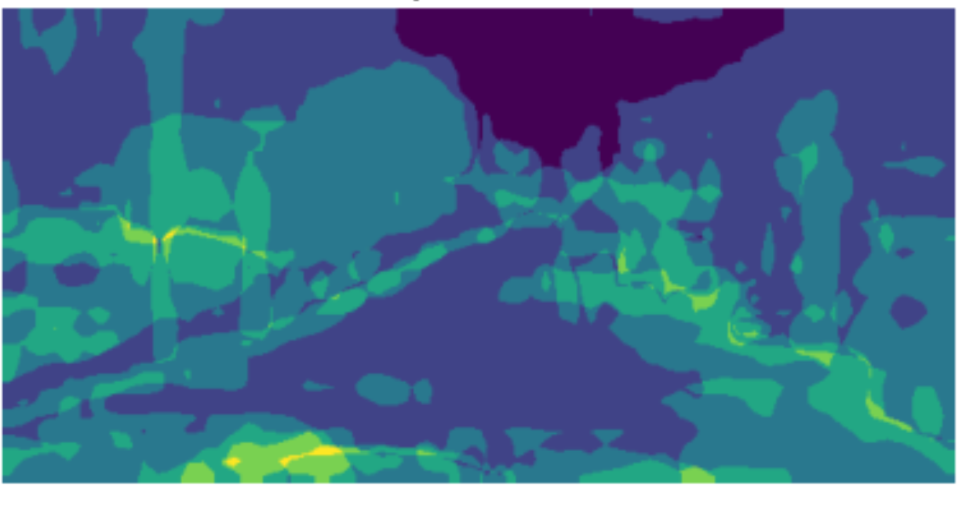
Proposed Method: Key technique 2
Conformal Prediction for Uncertainty Sets:
Following Mossina et al. (2024) and Angelopoulos and Bates (2022), we apply Conformal Prediction to quantify uncertainty for known class predictions.
Calibration: A calibration set (Cityscapes validation set) is used to determine a conformal threshold (q_{hat}​) on the UOS. The threshold (q_{hat}) is computed as the (1−α)-quantile of the UOS distribution on the calibration set, ensuring formal coverage guarantees for OoD detection.
Prediction Sets: For a new test pixel, a prediction set is formed by including all known classes whose predicted probability p_{k}​ satisfies p_{k}​≥(1−q_{hat}).
These prediction sets are guaranteed to contain the true label with a user-specified confidence level (1−α). The size of these sets can be visualized as a "Varisco heatmap" (Mossina et al.).

Slide 9
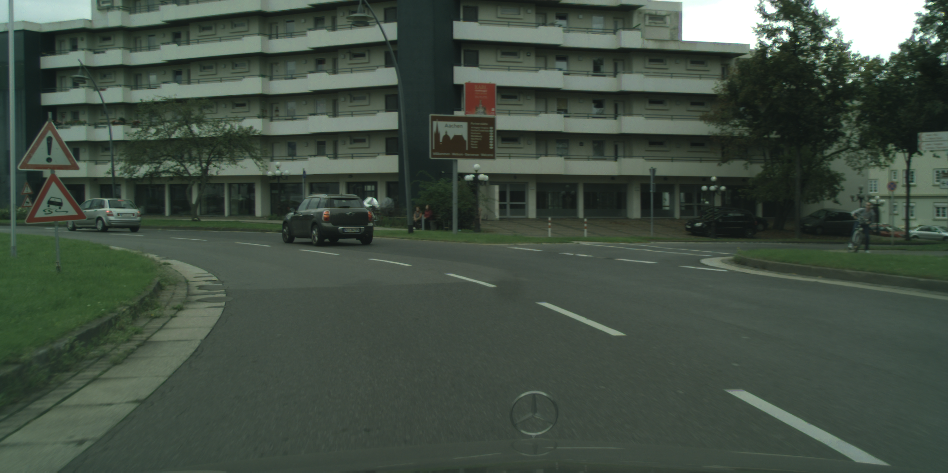
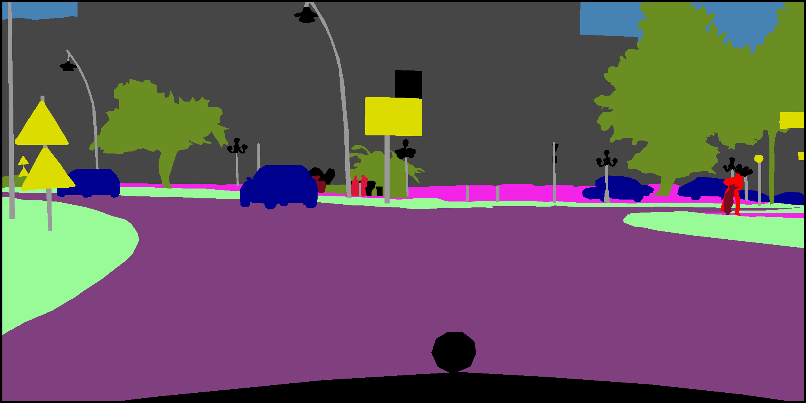
Dataset: Cityscapes Fine Annotation
Purpose: Used for training and validation of the semantic segmentation model on known urban scene categories.
Content: High-quality pixel-level annotations for 19 semantic classes in urban street scenes.
Processing:
The original 19 classes are mapped to 7 macro-classes to simplify the problem and focus on broader categories.
Pixels corresponding to IGNORE_INDEX (255 in original Cityscapes, typically void or unannotated regions) are explicitly ignored during training and evaluation.

Slide 10
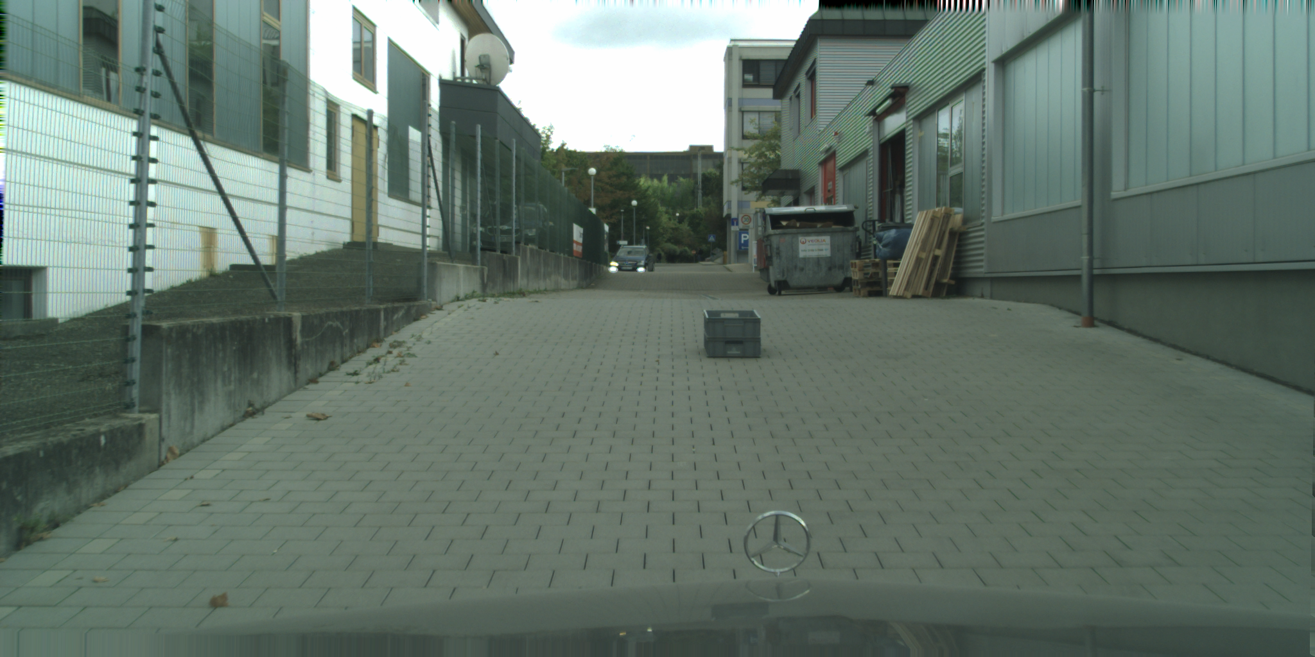
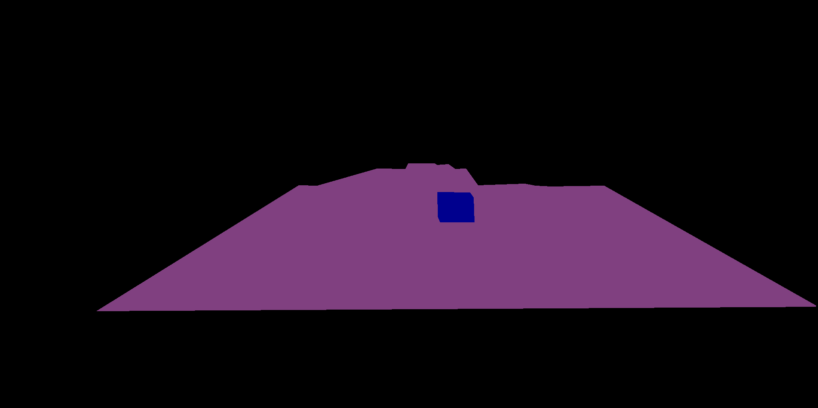
Dataset: LostAndFound
Purpose: Primarily used for evaluating the model's Out-of-Distribution (OoD) detection capabilities. This dataset contains images with various small, previously unseen obstacles.
Content: Urban driving scenes with additional annotations for "lost and found" objects (anomalies) that are not part of the standard Cityscapes classes.
Processing:
Known Cityscapes classes are mapped to the same 7 macro-classes as in Cityscapes.
Crucially, pixels identified as unknown obstacles in LostAndFound are mapped to a dedicated UNKNOWN_OBSTACLE_ID (7). This allows us to create a binary ground truth for anomaly detection (anomaly vs. non-anomaly).

Slide 11
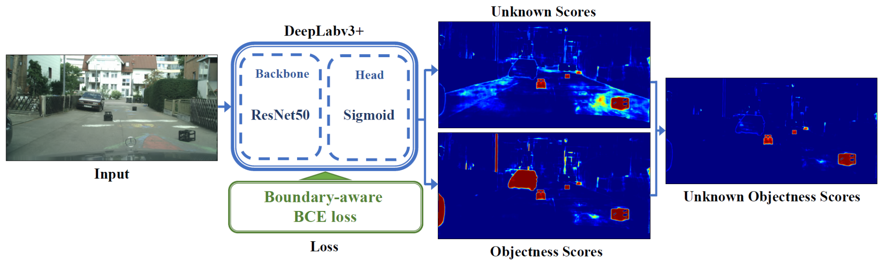
Experimental Setup: How we configured the elements of the project
Model Architecture: DeepLabV3_ResNet50.
Backbone: Initialized with ImageNet pre-trained weights (ResNet50_Weights.IMAGENET1K_V1).
Output Layer: Modified to output NUM_KNOWN_CLASSES = 7 channels, followed by sigmoid activation for independent class probabilities.
UOS Integration: We wrapped deeplabv3_resnet50 and added the logic to compute Objectness Score (p_{O}), Unknown Score (p_{US}), and their product, the Unknown Objectness Score (UOS).
Cross-Entropy Loss

Slide 12

Our parameters
Training Parameters:
Image Resize: (256, 512) for consistent input dimensions.
Optimizer: Stochastic Gradient Descent (SGD)
Learning Rate: Initial 0.01
Momentum: 0.9
Weight Decay: 0.0001
Learning Rate Scheduler: "Poly" learning rate policy with power=0.9.
Loss Function: nn.CrossEntropyLoss(ignore_index=255)
Checkpointing: Model state, optimizer state, epoch, and best mIoU are saved at the end of each epoch if validation mIoU improves.
Conformal Prediction Parameters:
Significance Level (𝞪): 0.1 (for 90% confidence intervals).
Calibration Set: Cityscapes validation set is used to calibrate the conformal prediction threshold (q_hat).

Slide 13
Model Evaluation: Known Class Performance
Methods | CityScapes mIoU
Original 19 classes | 0.6467
7 macro-classes | 0.7754
Metrics:
Validation Loss: Calculated using nn.CrossEntropyLoss on the 7 macro-classes, considering only valid pixels.
Mean IoU (mIoU): Computed on the 7 macro-classes, ignoring index 255. This measures the overlap between predicted and true segmentation masks for known classes.
Method:
The evaluate_model function handles the loss calculation and mIoU computation by converting sigmoid outputs to hard predictions.

Slide 14
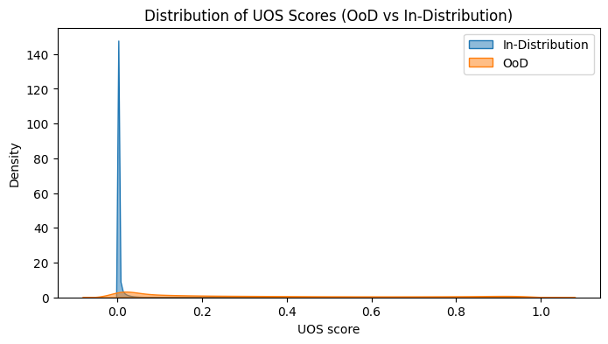
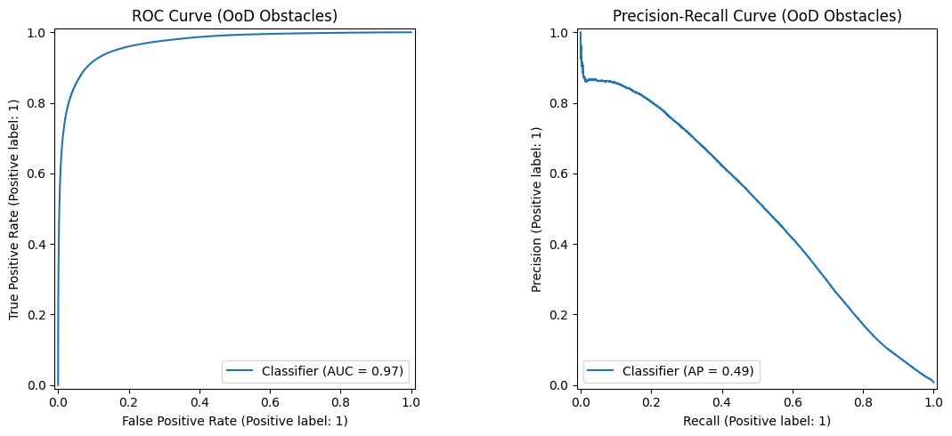
Model Evaluation: Anomaly Detection Metrics
Metrics:
Area Under the Receiver Operating Characteristic (AUROC): Ability of the UOS to distinguish between in-distribution (known) and out-of-distribution (anomaly) pixels.
False Positive Rate at 95% True Positive Rate (FPR@95TPR): Proportion of in-distribution pixels incorrectly classified as anomalies when 95% of true anomalies are detected.
Average Precision (AP): Standard metric for anomaly detection, showing the Precision-Recall Curve.
Method:
UOS scores are collected for all valid pixels in the LostAndFound test set.
Binary ground truth masks are created, where UNKNOWN_OBSTACLE_ID (7) pixels are labeled as 1 (anomaly) and all other valid pixels as 0 (not anomaly).
UOS values are optionally smoothed with a Gaussian blur for each image before evaluation.

Slide 15
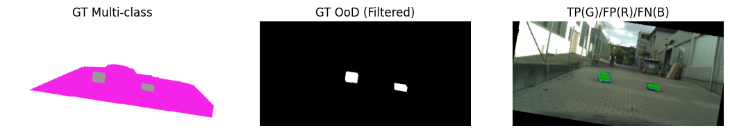
Model Evaluation: Anomaly Detection Metrics
Plots of OS, US and UOS.
Ground Truth, GT Binary Anomaly mask and Unknown Object prediction

Slide 16
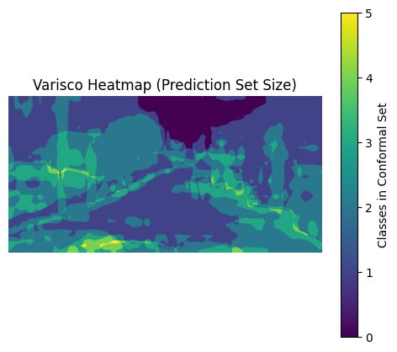
Model Evaluation: Uncertainty Quantification Metrics
Concept:
This part focuses on generating and visualizing conformal prediction sets to quantify per-pixel uncertainty.
Method:
Conformal Calibration: A q_hat (quantile) value is determined based on the UOS scores collected from the val_loader. This q_hat serves as a threshold for constructing prediction sets.
Varisco Heatmap Calculation: For each pixel in the test_loader, a p_threshold_conformal (calculated as 1 - q_hat) is applied to the sigmoid probabilities of the known classes.
The varisco_heatmap is generated by summing the number of known classes whose probability exceeds this p_threshold_conformal. This heatmap visually represents the size of the prediction set for each pixel, with higher values indicating greater uncertainty (larger sets) or lower confidence in a single prediction.

Slide 17
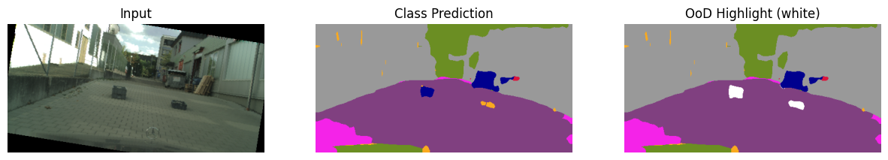
Results
𝞪 | T | q_{hat} | AUROC | AP | FPR95
0.05 | 1 | 0.493 | 0.966 | 0.418 | 0.167
0.05 | 2 | 0.715 | 0.966 | 0.486 | 0.171
0.05 | 4 | 0.828 | 0.965 | 0.523 | 0.182
0.1 | 1 | 0.088 | 0.964 | 0.419 | 0.179
0.1 | 2 | 0.381 | 0.968 | 0.490 | 0.164
0.1 | 4 | 0.613 | 0.965 | 0.517 | 0.184

Slide 18
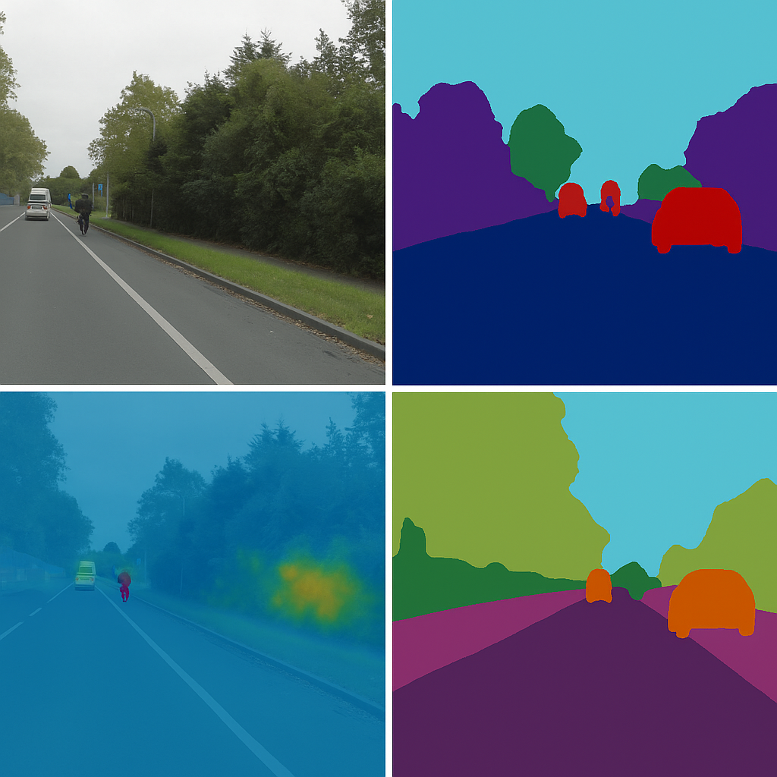
Conclusions: Final considerations
Known Class Segmentation: The model demonstrates a high mIoU on the Cityscapes validation set, indicating its ability to segment known urban categories.
Anomaly Detection: The AUROC and FPR@95TPR metrics quantify the effectiveness of the UOS in identifying unknown obstacles in the LostAndFound dataset.
Uncertainty Quantification: The project demonstrates the application of conformal prediction using Varisco heatmaps, that provide an indication of the spatial distribution of uncertainty across the image. This approach offers valuable pixel-level insights into model confidence for known classes.
Challenges Encountered: The LostAndFound dataset has a sparsity of anomaly pixels, and we need more robust data loading/filtering to ensure both positive and negative anomaly samples are present for metric calculation.

Slide 19

Future Work
Explore adaptive thresholding for UOS based on scene context or confidence levels.
Evaluate the computational overhead of conformal prediction for real-time applications.
Extend the framework to other safety-critical domains beyond autonomous driving.
Increase the versatility by handling more dynamic environments.

Slide 20
References
Noguchi, C., Ohgushi, T., & Yamanaka, M. (2024). Road Obstacle Detection based on Unknown Objectness Scores. arXiv [Cs.CV].
Mossina, L., Dalmau, J., & And ́eol, L. (2024). Conformal Semantic Image Segmentation: Post-hoc Quantification of Predictive Uncertainty. arXiv [Cs.CV].
Angelopoulos, A. N., & Bates, S. (2022). A Gentle Introduction to Conformal Prediction and Distribution-Free Uncertainty Quantification. arXiv [Cs.LG].
Cityscapes Dataset: "The Cityscapes Dataset for Semantic Urban Scene Understanding" (Cordts et al., 2016).
LostAndFound Dataset: "Lost and Found: Detecting Small Road Hazards for Self-Driving Vehicles" (Pinggera et al., 2016).

